Slide 1
Solution Design

Slide 2
Design: We concentrate on the third step
Define system boundary
Create structure of the solution
Refine the structure to implement the solution
  How can the conceptual elements be subdivided into subsystems?
  How do the subsystems look like?
  How do the subsystems interact with each other functionally?
Notes:
test

Slide 3

Design : How it goes
Divides a system into manageable subsystems
Defines the structure of the subsystems
Defines the interaction within each subsystem
Defines the interaction between subsystems
The structure is represented using Structural Model( aka Static Model)
The interactions are represented using Behavioural Model ( aka Dynamic Model)
Notes:
test

Slide 4
Design: Scale Matters
What is a System?
What is a Subsystem?
  Components, Classes, Service Components etc.
It all depends on the scale we are talking about
Notes:
test

Slide 5
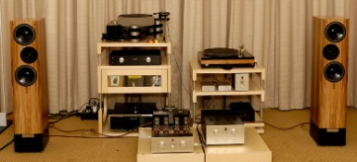
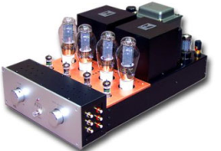
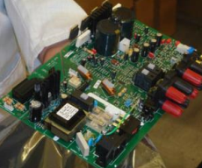
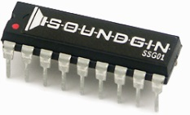
Design : Example of Scale
Let us take a different example
  The subsystems of a hi-fi are its tuner, amplifier, speakers, cables, and remote controls
  The subsystems of an amplifier are its case, the power supply, and the circuit board
  The subsystems of a circuit board are its resistors, fuses, and integrated circuits
  The subsystems of an integrated circuit are transistors and other components
Notes:
test

Slide 6
Design : Identify & Specify
Identification
  Identify the subsystems
  Determine relationship between the subsystems
  Outline interaction between the subsystems
Specification
  Specify the subsystems in detail
Notes:
test

Slide 7
Design: Identification
Partition the system into subsystems and assign responsibilities based on an analysis of the requirements
Use design patterns, architectural patterns, and other reusable assets that can be used as a starting point
Ensure the subsystems are well structured
Outcome
  One or more models showing the subsystems and relationship between them
    Structural Model
  One or more models showing collaborations inside and between subsystems
    Behavioural Model
Notes:
test

Slide 8
Design : Specification
Defining interfaces by separating out the responsibilities placed on the subsystems
For each interface, specifying the operations and their signatures, that is, parameters passed and return values
For each operation, specifying its contract of behaviour or pre- and post-conditions
Outcome
  Refined Structural Models
  Refined Behavioural Models
Notes:
test

